Slide 1
Analyses of Body Size, Flight, and Survival in Pierid Butterflies
Question: Which factor (sex, time, or weight) influence the survival probability the greatest?
Kingsolver, J. G., and R. B. Srygley. (n.d.). Experimental analyses of body size, ﬂight and survival in pierid butterﬂies:20.
By: FaithAnn Vanderwalker, Alex Emke, Andrew Beck, Jennifer Phelan, and Adam Orlando

Slide 2
Response Variable and Predictors
Response Variable: Survival Probability
Predictors: Sex (predictor for best model), Weight, Time

Slide 3
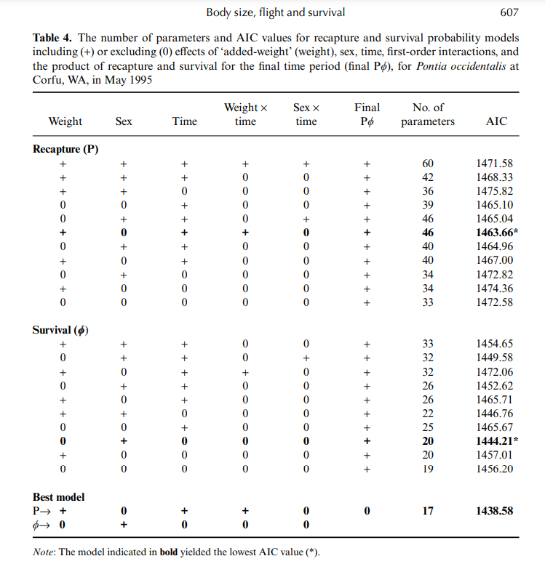
AIC Table

Slide 4
Important Models

Slide 5

Concluding Remarks
Sex had the biggest influence during the final time period of the study.
Weight and time had less significant influences during this time.

